Slide 1
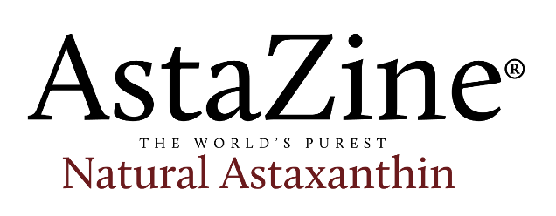

Slide 2
From the Pure Waters of
the Himalayan Mountains…

Slide 3
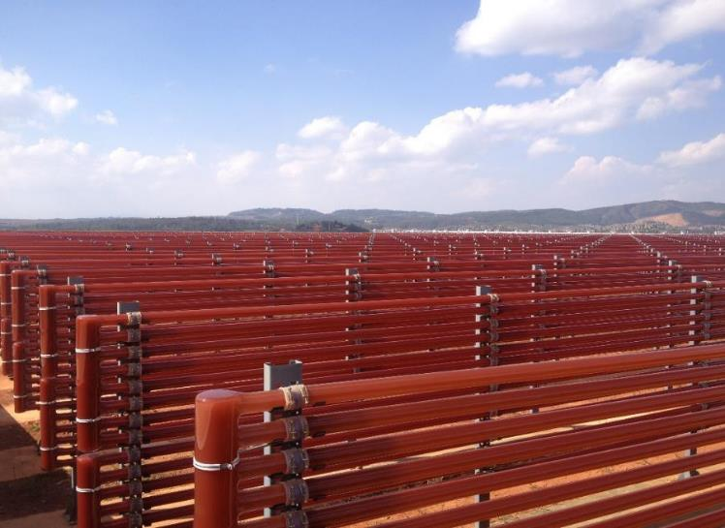
...to the World’s Second Largest Astaxanthin Farm

Slide 4
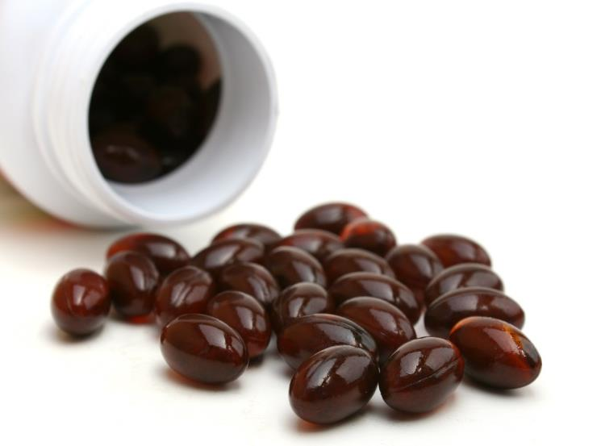
YOU CAN FEEL
Introducing:
The supplement

Slide 5
OUR COMPANY
Focus is on unsurpassed quality at reasonable pricing
Biggest market is Japan (with the world’s toughest quality standards)
Supplying most of the world’s largest supplement companies
Algae Health Sciences (AlgaeHealth) is a subsidiary of BGG dedicated to the research, development and marketing of products from algae

Slide 6
OUR COMPANY
Founded in 1995
450 employees and 6 production sites
32 patents and 5% of revenue invested in R&D
Facilities in USA, Japan, Europe and China

Slide 7
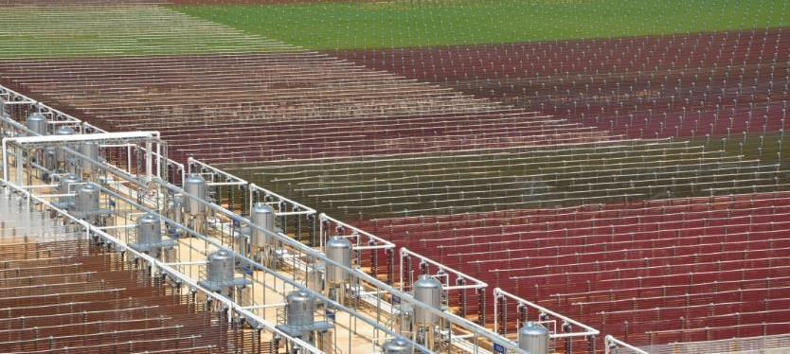
OUR FARM
LEADING HAEMATOCOCCUS FARM
World’s second largest Natural Astaxanthin producer
All glass tubing to protect from contamination
Natural process using the sun’s energy
Pristine growing region, clean air & water

Slide 8
OUR FARM
WORLD CLASS LABORATORIES
State-of-the-art
Ultra-hygienic
“Most impressive labs on the algae scene”

Slide 9
OUR FARM
CAPACITY EXPANSION
Nearby land earmarked for expansion
Doubling size of farm to 160 acres (64 hectares)
World’s largest producer by 2021

Slide 10
OUR FARM
EXPANSION CAPABILITY
Worldwide Astaxanthin demand exceeded supply from 2011 – 2014
Every supplier was out-of-stock with horrible lead times
This will never happen again due to AlgaeHealth’s:
Ability to expand capacity quickly and efficiently
(Went from small producer to world’s second largest in only 6 months)

Slide 11
OUR FARM
WATER SOURCE
From the Tibetan Plateau in the Himalayan Mountains
Run through reverse osmosis for additional safety

Slide 12
OUR FARM
Located next to the Pristine Stone Forest
ENVIRONMENTAL RESPONSIBILITY
One of our most important guiding principles
Using the sun’s energy
Minimal water use and water recycling
Closed system with no runoff into the environment

Slide 13
OUR PRODUCT
Purest and most concentrated Astaxanthin in the world
PUREST AND MOST CONCENTRATED ASTAXANTHIN IN THE WORLD
Purest Natural Astaxanthin in the world
Carotenoid fraction is 97% Pure Astaxanthin
Other producers generally range from 85% to 95% Pure
Most concentrated Natural Astaxanthin in the world
6.0% to over 8.0% concentration in the algae biomass
Other producers generally range from 2.0% to 5.0%

Slide 14
OUR PRODUCT
CONTAMINANTS FOUND IN OTHER ASTAXANTHIN PRODUCTS
Frequent testing of heavy metals without detectable levels
Pesticide and herbicide screens consistently show no detectable levels
Screen of benzopyrene, PAHs, PCBs and aflatoxins without detectable levels
Solvent-free supercritical CO2 oleoresins

Slide 15
OUR PRODUCT
VITAL CONTAMINANT CONCERN
Glyphosate (RoundUp®) is becoming ubiquitous in many countries in the food chain and in many supplements
Peer-reviewed study: Levels as low as 50 parts per trillion resulted in liver and kidney damage in rodents
AstaZine® was found free of Glyphosate to detection limits of less than 26 parts per trillion

Slide 16
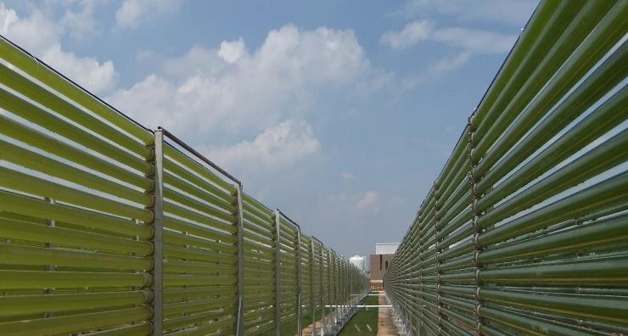
OUR PRODUCT
LEADING ASTAXANTHIN PRODUCER
Clinically-validated product: Only three Astaxanthin producers have sponsored clinical research on their product
Seven years perfecting production techniques and isolating a superior strain of algae before full-scale production
Best growing system: Closed tube system to prevent contamination
Cutting-edge technology: Purest; most concentrated; world’s first organic Astaxanthin product
Accurate analytical method and stable raw materials

Slide 17
OUR PRODUCT
WORLD’S FIRST ORGANIC ASTAXANTHIN
World’s First Organically Certified Astaxanthin Crop
World’s First Organically Certified Astaxanthin Product: AstaZine® Natural Astaxanthin 5% Haematococcus pluvialis powder
Certified by leading European organic certifier: ECOCERT

Slide 18
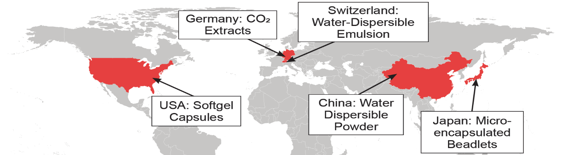
OUR PRODUCT
GLOBAL SUPPLY CHAIN: SOURCING FROM THE BEST-OF-THE-BEST
Beadlets: Made in Japan
Water-Dispersible Emulsion: Made in Switzerland
Supercritical CO2 solvent-free oleoresins: Made in Germany
Softgels: Made in USA
Water-Dispersible Powder: Made in China

Slide 19
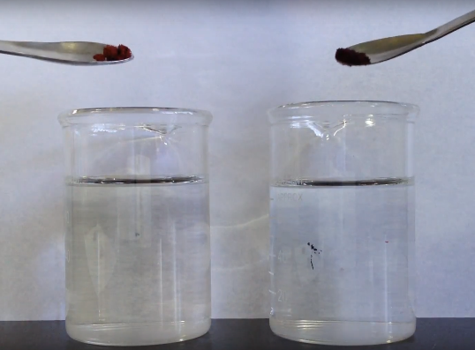
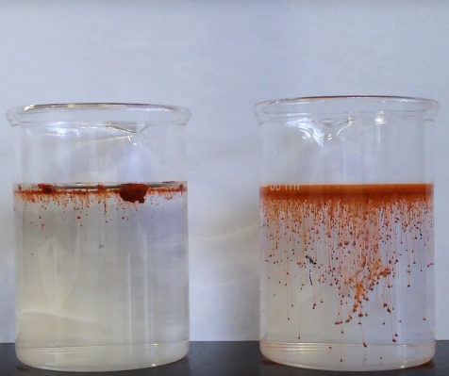
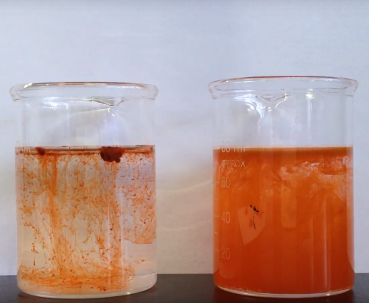
OUR PRODUCT
WATER DISPERSIBLE ASTAXANTHIN VERSUS LEADING COMPETITOR
AstaZine® water dispersible powder is on the right in each photo
Quick dispersion without stirring
Competitive product doesn’t disperse properly even after stirring

Slide 20
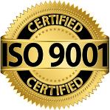
OUR PRODUCT
QUALITY: PRODUCED UNDER CGMP ACCORDING TO 21 CFR 111
Member of NAXA
ISO 9001-2008
ISO 22000-2005
HACCP
All Natural Process
Certified Organic Farm
Vegan
Allergen and Solvent Free
Non-Irradiated
Kosher & Halal
Non-GMO Project Verified

Slide 21
PRODUCTS FROM NON-NAXA SUPPLIERS
Member of NAXA
Some consumer products labeled “Natural” are actually Synthetic Astaxanthin
15 commercial products tested
Only 3 had the stated level of Astaxanthin present
80% were cheating the consumer
1/3 of the products tested had less than half of label claim
From the book “The World’s Best Kept Health Secret: Natural Astaxanthin”

Slide 22
MAJOR DIFFERENCES FROM SYNTHETIC ASTAXANTHIN
Source: Natural is extracted from algae while Synthetic is synthesized from petrochemicals
Strength: Natural is 20 – 90 times stronger as an antioxidant
Animal Trials Prove Superiority: Six different animal trials prove Natural has superior health benefits
Safety: Natural has an extensive portfolio of human safety studies and over 20 years of commercial use; Synthetic has never been tested for safety in humans
Efficacy: Natural has been clinically validated to have many diverse health benefits in over 100 human clinical trials; Synthetic has never been shown to have any health benefits

Slide 23
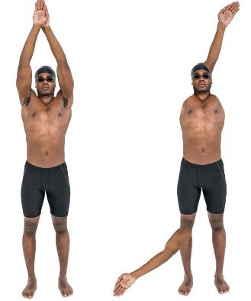
SHAPE MATTERS
Synthetic Astaxanthin is produced from petrochemicals similar to the oil you put into your car’s crankcase
A swimmer shaped differently wouldn’t perform the same either
Natural and Synthetic Astaxanthin molecules are shaped differently
Natural is esterified with a fatty acid molecule attached to the end of the molecule while Synthetic is non-esterified
Natural comes complexed with a small amount of naturally occurring carotenoids while Synthetic does not
End result: Natural performs far better than Synthetic
Regulatory Status: Natural is approved by regulators in all major markets and most smaller markets. Synthetic is not approved in many markets (including EU & Japan)

Slide 24
ALGAEHEALTH FIRSTS
First Organically Certified Astaxanthin Product
Only Astaxanthin producer with two Novel Foods approvals in Europe for different Astaxanthin extraction methods
By far the most Structure Function Claims submitted to US FDA without objection (239)
Two Astaxanthin use patents pending
Only US FDA NDI over 12 mg per day dosage
24 mg per day: Recommended for initial 30 days as a “loading phase” and for the 30 days immediately preceding a “big event” for athletes

Slide 25
ALGAEHEALTH DOES NOT COMPETE WITH OUR CUSTOMERS
ASTAXANTHIN PRODUCERS WITH THEIR OWN BRANDS ARE BECOMING PREVALENT
Out of the top five Astaxanthin producers, four producers own their own consumer brand of Astaxanthin
They are competing in the retail market with their own customers
They will always give preference to their own brand over their customers’ brands
AlgaeHealth is the ONLY one of the top five Astaxanthin producers that does not own their own consumer brand

Slide 26
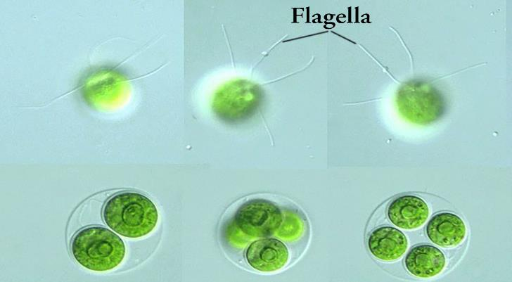
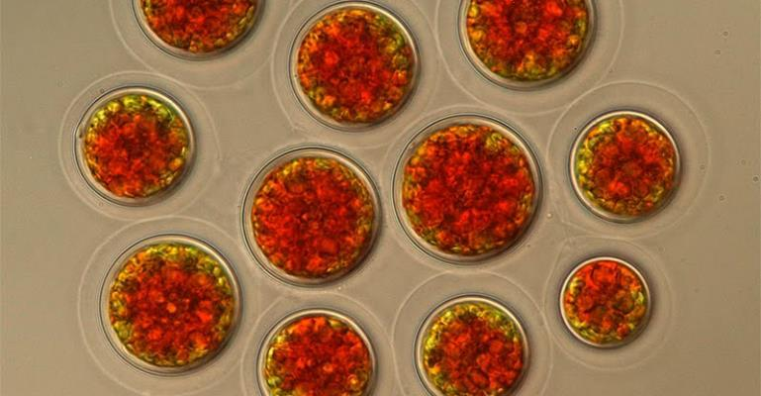
WHAT IS ASTAXANTHIN?
Haematococcus pluvialis algae cells turn from green to red as they accumulate the carotenoid Astaxanthin when subjected to environmental stress
Astaxanthin serves as a “force field” to protect the algae cells
Astaxanthin is so protective the cells can live for over 40 years without food or water and in extreme climatic conditions
When ingested by humans or animals, Astaxanthin gets throughout the entire body and protects our cells just like it protects the algae cells

Slide 27
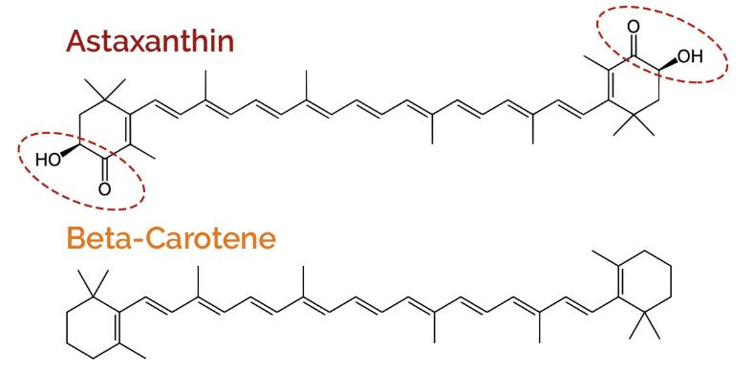
CHEMICAL STRUCTURE
Astaxanthin molecule is different from other carotenoids
Hydroxyl groups on the end of the molecule provide unique benefits

Slide 28
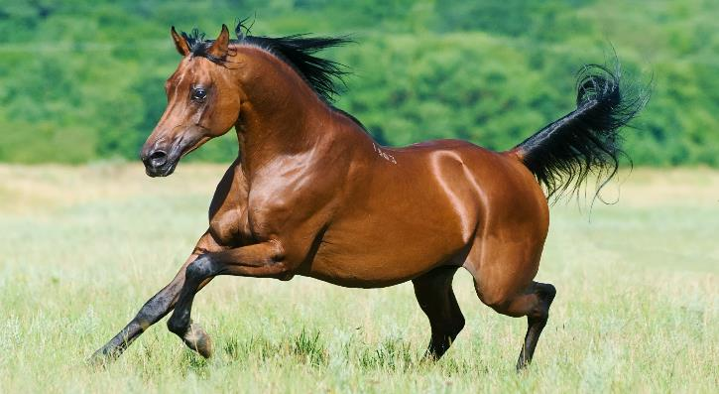
ORIGINALLY USED FOR ANIMAL FEEDS
Cures a life-threatening muscle disease in horses
Increases salmon fry survival rates from 17% to 87% when only 1 ppm is added to salmon feed
83% of shrimp larvae fed Natural Astaxanthin lived to maturity while only 28% fed Synthetic Astaxanthin did
Used for strength and health in sled dogs
Nestle Purina’s top researcher says Astaxanthin caused the most noticeable change he ever saw in over 20 years of testing nutrients in sled dogs

Slide 29
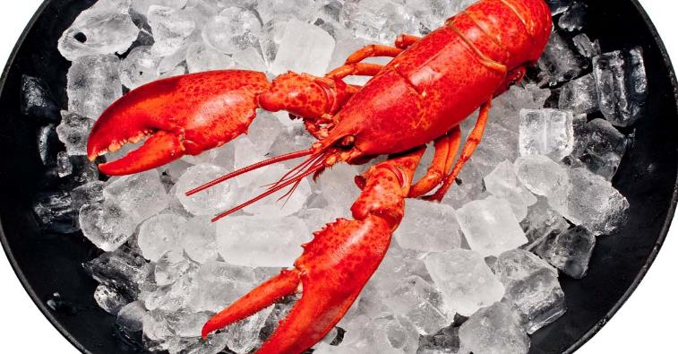
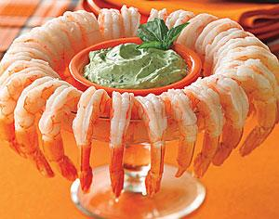
SAFETY OF NATURAL ASTAXANTHIN
In the food chain in salmon, lobster, shrimp, crab and trout plus over 20 years as a dietary supplement
Multiple small mammal studies up to 12,000 to 17,000 mg/kg per day showed no signs of toxicity, cancer formation or birth defects
Chronic and acute safety studies in humans

Slide 30
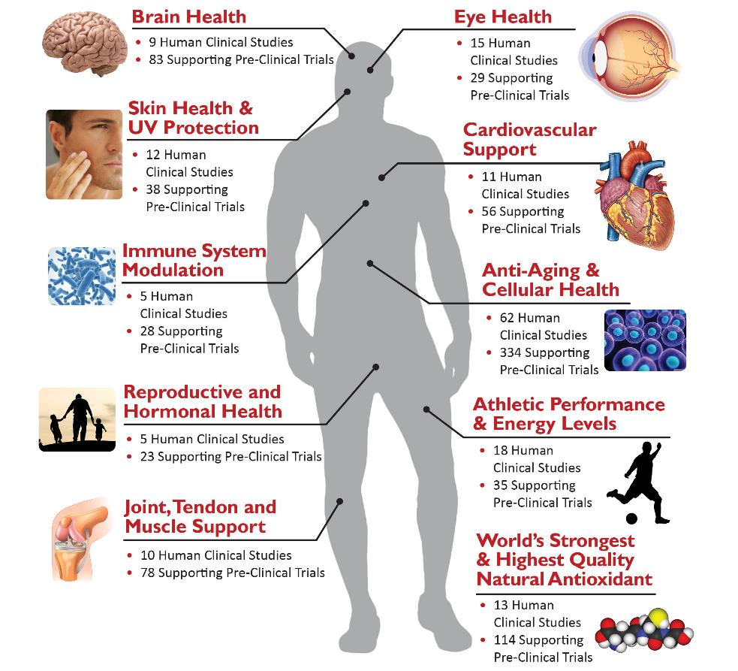
“THE HEALTHY TEN”
TEN CLINICALLY-VALIDATED BENEFITS OF NATURAL ASTAXANTHIN
Approximately 100 new studies each year over the last three years

Slide 31
ASTAZINE® PROPRIETARY RESEARCH
PEER-REVIEWED PUBLICATION, TALBOTT ET AL., 2017
12mg per day over 60 days
10% decrease in heart rate at submaximal endurance intensities
In long distance running (not sprinting), AstaZine® enabled the heart to function well at 10% slower heart beat
“Cardiotonic Effect”
Patent pending

Slide 32
Negative Mood State Parameters all Decreased
ASTAZINE® PROPRIETARY RESEARCH
PEER-REVIEWED PUBLICATION, TALBOTT ET AL., 2019
Looking at benefits for athletes from a different angle: Mood state
Athletes supplementing with AstaZine® experienced:
11% better overall mood state
36% less mental fatigue
57% less feelings of depression
Statistically significant at p < 0.05
Patent pending

Slide 33
Relative Singlet Oxygen Quenching Activity
WORLD’S STRONGEST
NATURAL ANTIOXIDANT
Singlet Oxygen Quenching
6000 times stronger than Vitamin C
800 times stronger than CoQ10
550 times stronger than Green Tea Catechins
75 times stronger than Alpha Lipoic Acid

Slide 34
WORLD’S STRONGEST NATURAL ANTIOXIDANT
Oxygen Free Radical Scavenging
14X – 60X stronger than other antioxidants in free radical scavenging
20X stronger than Synthetic Astaxanthin in free radical scavenging

Slide 35
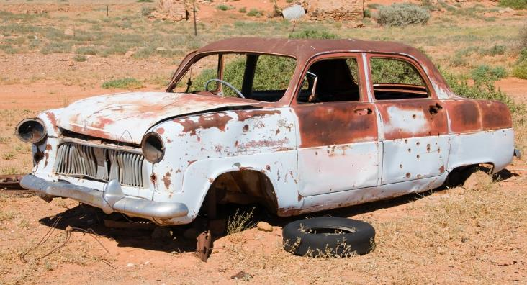
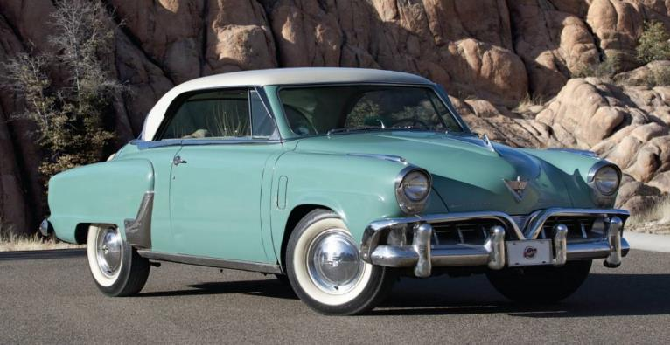
WORLD’S HIGHEST QUALITY ANTIOXIDANT
Oxidation in our bodies is like a car rusting
We need a high quality antioxidant to prevent our bodies from rusting
Astaxanthin has six distinct properties that other antioxidants do not possess
Some antioxidants may share a few, but no other antioxidant has all six
Astaxanthin provides a “fresh coat of paint” to protect our bodies

Slide 36
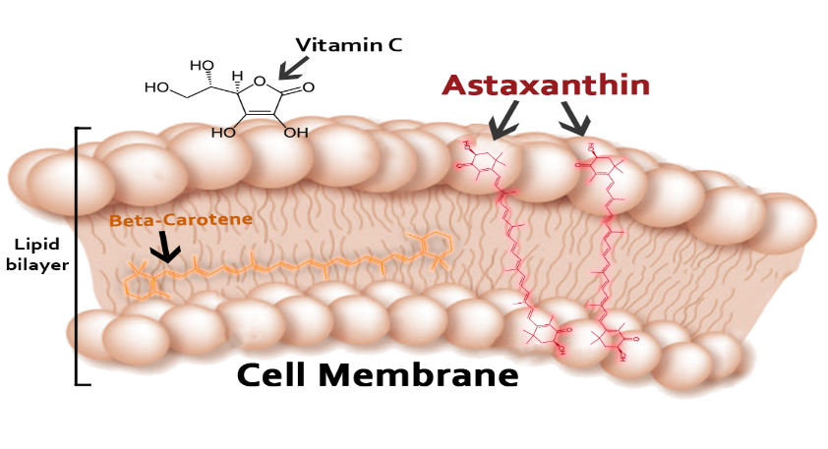
1. WORLD’S HIGHEST QUALITY ANTIOXIDANT
SPANS THE CELL MEMBRANE
The Astaxanthin molecule is exceptionally long
It spans the cell membrane to protect the entire cell
Protects both the fat-soluble and water-soluble parts of cells

Slide 37
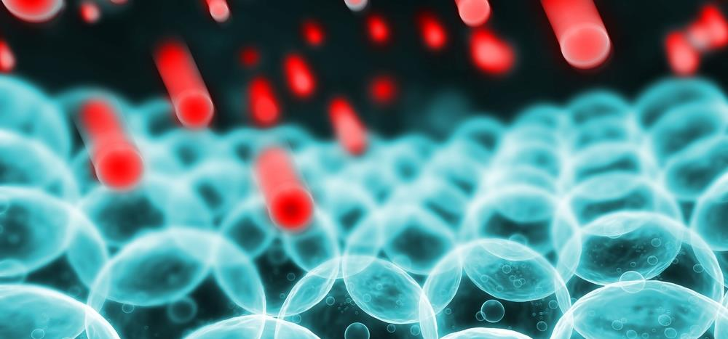
2. WORLD’S HIGHEST QUALITY ANTIOXIDANT
HANDLES MANY FREE RADICALS SIMULTANEOUSLY
Remains active as an antioxidant longer and can handle many free radicals at the same time
Astaxanthin is believed to be able to handle between 13 and 19 free radicals simultaneously
Neutralizes various types of free radicals

Slide 38
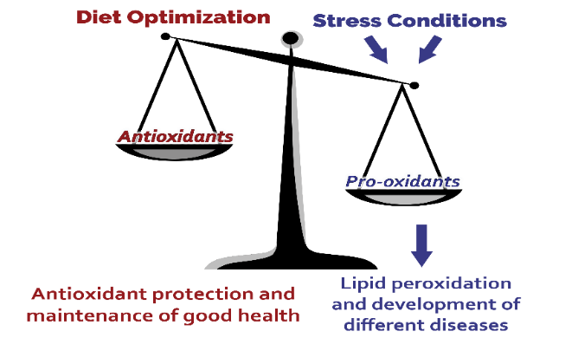
3. WORLD’S HIGHEST QUALITY ANTIOXIDANT
Antioxidant/Pro-Oxidant Balance in the Cell
NEVER BECOMES A PRO-OXIDANT
Many good antioxidants can become Pro-Oxidants under certain condition and cause damage to cells
Astaxanthin can never become a Pro-Oxidant

Slide 39
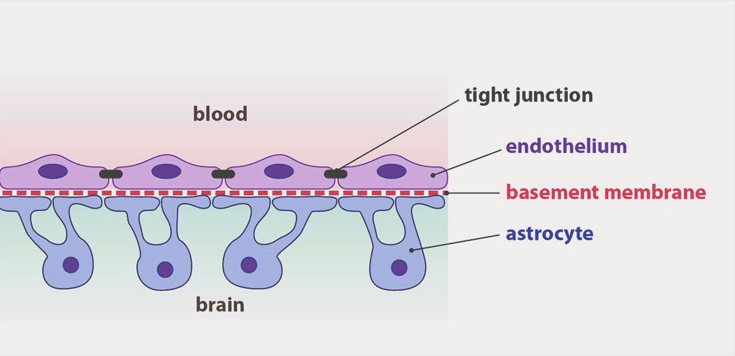
4. WORLD’S HIGHEST QUALITY ANTIOXIDANT
CROSSES THE BLOOD-BRAIN AND BLOOD-RETINAL BARRIERS
Astaxanthin crosses the blood-brain barrier to bring its profound antioxidant activity and broad-spectrum anti-inflammatory properties to help protect the brain
Once in the brain, Astaxanthin crosses the blood-retinal barrier to help protect the eyes

Slide 40
5. WORLD’S HIGHEST QUALITY ANTIOXIDANT
BONDS WITH MUSCLE TISSUE
Astaxanthin can bond with muscle tissue to control oxidation and inflammation
Combats increased oxidation in muscle tissue caused by physical activity

Slide 41
6. WORLD’S HIGHEST QUALITY ANTIOXIDANT
ACCUMULATES IN THE SKIN
Astaxanthin accumulates in the skin
Improves skin health and appearance
Prevents UV damage

Slide 42
SAFE & NATURAL ANTI-INFLAMMATORY
Tumor Necrosis Factor-A
Prostaglandin E-2
Interleukin 1-b
Interleukin 6
Inflammatory Markers
Nuclear Factor Kappa-B
Cox 2 enzyme
Nitric Oxide
Cox 1 enzyme
BROAD-SPECTRUM ACTIVITY WITH NO SIDE EFFECTS
Significantly reduces 8 different inflammatory markers
No side effects or contraindication but takes 2 – 6 weeks to work
OTC and prescription anti-inflammatories all have dangerous side effects, some that can kill you

Slide 43
PAIN RATE IN RHEUMATOID ARTHRITIS SUFFERERS
GRIP STRENGTH
mmHg
+/- 270
+/- 321
SAFE & NATURAL ANTI-INFLAMMATORY
PAIN & MOBILITY
Clinically validated to reduce pain and increase mobility in people suffering from painful conditions such as rheumatoid arthritis and carpal tunnel syndrome
Increases grip strength by almost double in people suffering from tennis elbow (tendonitis)
Prevents joint pain after exercise in healthy subjects

Slide 44
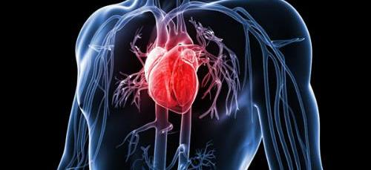
SAFE & NATURAL ANTI-INFLAMMATORY
SILENT INFLAMMATION
Reduces C-reactive protein levels, the key marker for deadly systemic (also known as “silent”) inflammation
20% reduction in 8 weeks
Silent inflammation is a leading cause of heart disease, cancer, diabetes, Alzheimer’s, Parkinson’s and many other life-threatening maladies
The American Heart Association believes that C-reactive protein is a better predictor of heart disease than cholesterol levels

Slide 45
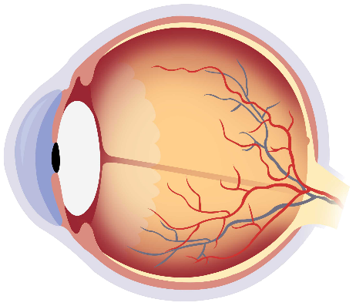
EYE HEALTH
Prevents and reduces eye fatigue and eye strain (ten positive human clinical studies)
Improves visual acuity (the ability to see fine detail)
Protects the eyes from UV damage
Improves eye accommodation (depth perception and focus)
Increases blood flow to the retina
Age-related macular degeneration (animal studies)

Slide 46
BRAIN HEALTH
Prevention of dementia
Improvement of age-related decline in cognitive and psychomotor function
Decrease in age-related forgetfulness
Improves mood state
Latest brain health research: Renowned researcher Paula Bickford, PhD has started animal trials which show neurotoxicity benefits in model for Parkinson’s

Slide 47
SKIN HEALTH & UV PROTECTION
Prevention of photo-aging
Prevention of UV damage
Prevention of skin cancer (animal studies)

Slide 48
“BEAUTY FROM WITHIN”
% IMPROVEMENT
Assessment of Beauty Parameters
LANDMARK CLINICAL TRIAL
4 mg per day
Fights wrinkles
Increases skin moisture levels
Improves skin elasticity
Reduces visible signs of UV-aging within 4-6 weeks of use
Helps maintain a youthful appearance

Slide 49
TOPICAL BENEFITS OF ASTAXANTHIN
HUMAN AND ANIMAL STUDIES
Wrinkle reduction
Protection from sun damage
Reduction in premature signs of aging
Treatment of allergic skin conditions

Slide 50
NATURE’S AQUATIC MARATHON
The highest concentration of Astaxanthin in animals is in salmon where it concentrates in their muscles
Astaxanthin gives salmon the strength and energy to perform nature’s greatest endurance feat—swimming up raging rivers for weeks

Slide 51
THE ATHLETE’S DOZEN
THE 12 CLINICALLY-VALIDATED BENEFITS FOR ATHLETES
Strength
Endurance
Recovery
Performance
Muscle Damage
Heart Rate
Mental Fatigue
Physical Fatigue
Energy Metabolism
Lactic Acid Levels
Joint & Muscle Soreness
Mood State

Slide 52
STUDY SPONSORED BY GATORADE® IN COMPETITIVE CYCLISTS
4mg per day over four weeks
20 km time trial
Made the cyclists 5% faster
Increased power output by 15%

Slide 53
CARDIOVASCULAR HEALTH
Delay in Oxidation of LDL Cholesterol
Improves blood lipid levels
Prevents lipid peroxidation
Decreases systolic and diastolic blood pressure by 5% to 7%
Reduces heart rate by 10% during exercise
Improves blood flow

Slide 54
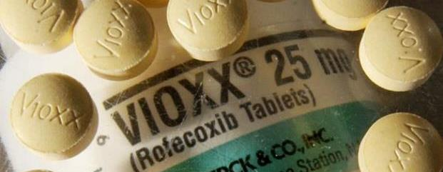
CARDIOVASCULAR HEALTH
Anti-Inflammatory drug Vioxx® was taken off the market after causing many deaths from heart disease
Harvard Medical School study showed that Astaxanthin completely negates the pro-oxidant effects of Vioxx®
If Merck had added a little Astaxanthin to their Vioxx®, they would have saved $5 billion in lawsuit settlement fees (and more importantly, they would have prevented many deaths)

Slide 55
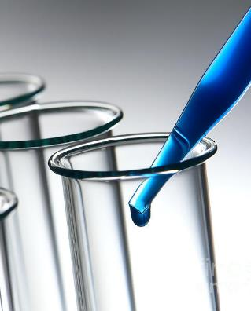
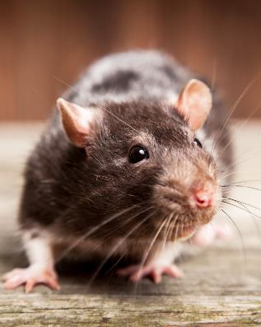
IMMUNE MODULATION
LANDMARK WASHINGTON STATE UNIVERSITY SERIES OF STUDIES
In-vitro, rodent, cat, dog and human clinical studies
Human study: 0mg, 2mg and 8mg per day over eight weeks
Improvement in several immune markers
Decrease in DNA damage by 40%
Reduction in CRP levels and oxidative stress
“Astaxanthin is a strong immune system stimulator”

Slide 56
MALE FERTILITY
Clinical trial done at 16mg per day over three months
Increased sperm velocity and reduced reactive oxygen species in sperm
Over 50% of couples with the male diagnosed with poor semen quality had a baby!

Slide 57
ANTI-AGING & CELLULAR HEALTH
Clinically validated benefits for most of the key concerns with aging
AstaZine® study in C. elegans (a worm that serves as a model organism for longevity testing in mammals) showed AstaZine® group lived 10% longer on average with a 17% maximum increase in survival
The Ultimate Anti-Aging Nutrient

Slide 58
EMERGING RESEARCH
PRE-CLINICAL STUDIES IN ANIMALS AND IN-VITRO
Cancer Prevention and Tumor Reduction 63 studies
Liver & Kidney Health 50 studies
Support for Diabetes 32 studies
Gastrointestinal Health 19 studies
Respiratory Health 7 studies

Slide 59
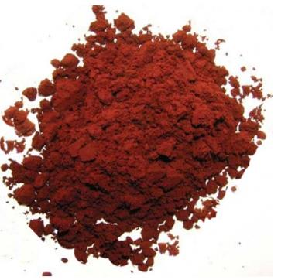
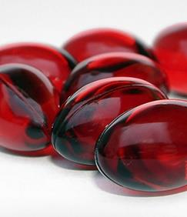
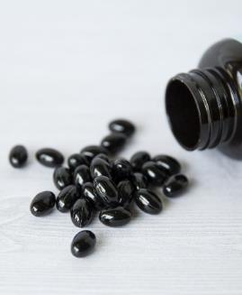
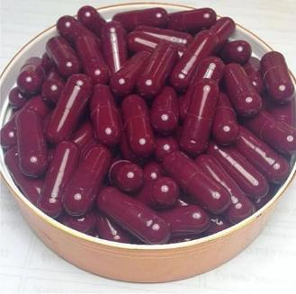
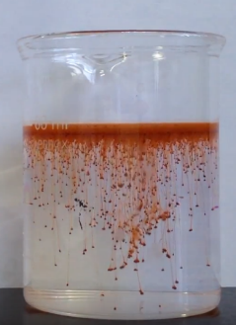
ASTAZINE® PRODUCT FORMATS
Certified Organic 2.5% free-flowing powder, 5% powder and 10% oleoresin
Supercritical CO2 solvent-free extraction and ethanol extraction
5%, 10% and 20% oleoresin
2.0% and 2.5% beadlets
2.0% water-dispersible powder and 1.0% water-dispersible emulsion
4mg, 6mg, 8mg, 12mg bovine gelcaps and vegetarian gelcaps (available in select markets)
Private label bottles “Made in USA” (available in select markets)

Slide 60
RECOMMENDED DOSAGES
Antioxidant 2 – 4 mg per day
Immunity 2 – 4 mg per day
Skin Health 4 – 6 mg per day
Eye Health 4 – 8 mg per day
Athletes & Energy 4 – 12 mg per day
Anti-Aging 4 – 12 mg per day
Joint, Tendon & Muscle 4 – 12 mg per day
Cardiovascular Health 4 – 18 mg per day
Brain Health 6 – 12 mg per day
Male Fertility 16 mg per day
Topical Applications 20 – 50 ppm

Slide 61
STRUCTURE FUNCTION CLAIMS
239 different health claims submitted to US FDA without objection
By far the most of any Astaxanthin supplier
The ultimate nutrient to support the brain and eyes
Helps maintain beautiful, younger looking skin
Promotes healthy joints, tendons and synovial fluids
Helps support cardiovascular function and a healthy circulatory system
Promotes improved performance in athletes
Nutritional support in the battle against aging

Slide 62
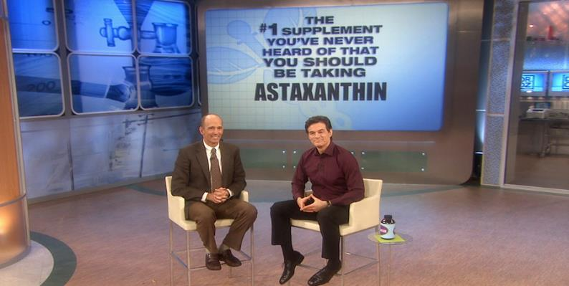
REPEAT BUSINESS
“THE SUPPLEMENT YOU CAN FEEL”
80% of people can feel or see it working
Great repeat business
Dr. Mercola on the Dr. Oz show: “The #1 Supplement You Should Be Taking”

Slide 63
MARKETING ASSISTANCE
ALGAEHEALTH PROVIDES UNPARALLELED SUPPORT FOR OUR CUSTOMERS
White Papers
Abstract Lists
Astaxanthin Book
Marketing Consultation and Guidance

Slide 64
THANK YOU FOR YOUR ATTENTION
For questions or more information please contact us at algaehealthsciences.com or bggworld.com
These statements have not been evaluated by the Food and Drug Administration.
This product is not intended to diagnose, treat, cure, or prevent any disease. Please note that the physiological activity of the ingredient described herein is supported by the referenced clinical trial reports. Marketers of finished products containing the ingredient described herein are responsible for determining whether the claims made for such products are lawful and in compliance with the laws of the country in which they will market the products.

